Slide 1

Automated Trading
Using Python and Keras neural nets

Slide 2

The Opportunity
Financial markets are getting less stable over time, leading to higher volatility
This creates a huge opportunity to profit, if an automated agent can be trained to take advantage of price movements
I have been trading for 20 years and want to automate as much as possible

Slide 3

What factors are there to consider?
First and foremost – risk management! Markets move fast and can be very, very dangerous without proper safety precautions such as stop-losses and circuit breakers.
Reliability of the agent, ability to learn over time

Slide 4

Data Acquisition and Preparation
Notebook here
I have been collecting intraday trading data for Bitcoin vs USD from Tiingo with a frequency of 1 minute for about 6 weeks, and as of the 14th of October 2020 that amounted to about 95,000 rows of data. A huge benefit of financial data is that it is generally very clean, so there was not a huge amount of work to do on this front, with very little pre-processing necessary. I also downloaded daily price data, but for Bitcoin this amounts to under 3,000 rows of data, so I will initially be analysing the daily data.

Slide 5
Show me the money!
I calculated a reward metric which is a figure that risk-adjusts the overall profit on a trade, by dividing the profit by the maximum drawdown during the holding period. I initially made the trade holding period 5 minutes, but will eventually explore many different timeframes. I will add a large range of technical indicators as features to the dataset, and then explore whether they have predictive power in predicting reward as y.

Slide 6

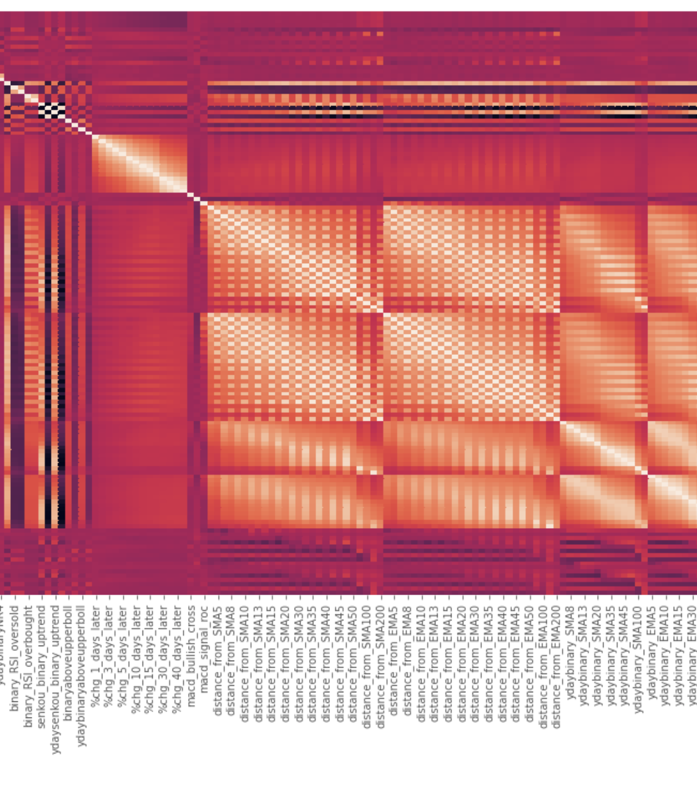
EDA
Notebook here

Slide 7

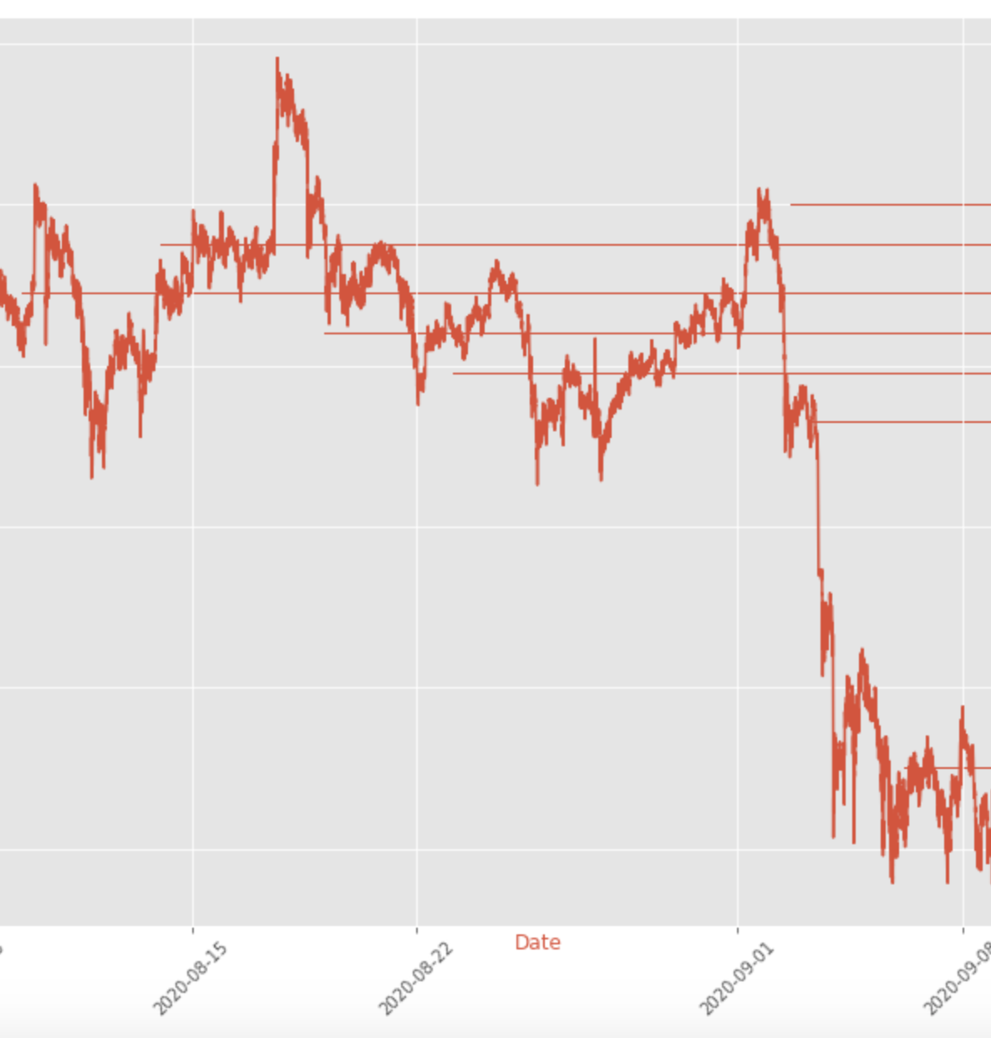
Features
I used my domain knowledge to create a range of indicators, including my personal favourite, the VPOC

Slide 8
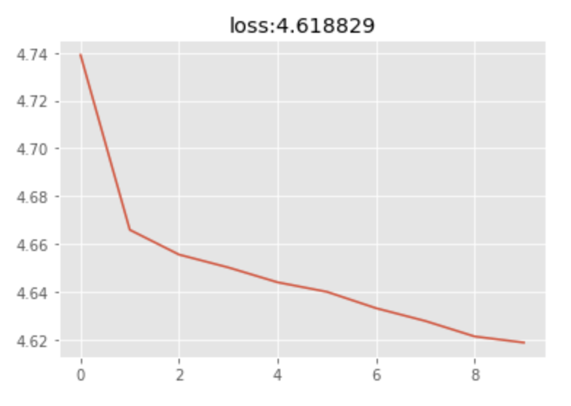
The Modeling
Notebook here
Encouraging initial results

Slide 9

Further work
I have much more work to do in terms of adding and refining features, hyperparameter tuning and model tweaking, but the early results are very encouraging.

Slide 10
Thanks
A huge thank you to my exceptional Springboard mentor Dhiraj Khanna, who's phenomenal advice helped me in many different ways.

